Slide 1
Lead User Guide: Abatement Notifications
Updated 06/14/2019
Notes:
Welcome to the online tutorial for the Lead program’s Abatement Notifications application. This tutorial will walk you through the process of completing and submitting an Abatement Notification to EPA through the Central Data Exchange (CDX).

Slide 2
Abatement Notification Role for new CDX user
Notes:
If you are a new CDX user click the “Register with CDX “ button. You will be directed to the CDX Terms and Conditions page.
Note: If you are a current CDX user looking to add the Abatement Notifications role to your account proceed to slide 15.

Slide 3
Abatement Notification Role for new CDX user
Notes:
On the CDX Terms and Conditions page, read the terms and conditions then check the box and click “Proceed.”

Slide 4
Abatement Notification Role for new CDX user
Notes:
Click on Lead: Lead-Based Paint Program, you will then be directed to Role Access page.

Slide 5
Abatement Notification Role for new CDX user
Notes:
From Select Role dropdown, select “ABATEMENT NOTIFICATION” and click Request Role Access. You will be directed to the User and Organization Information Page

Slide 6
Abatement Notification Role for new CDX user
Notes:
On the User and Organization Information page, enter all required user information. For Organization Info section, enter the name of your Organization or Organization ID and click Search.

Slide 7
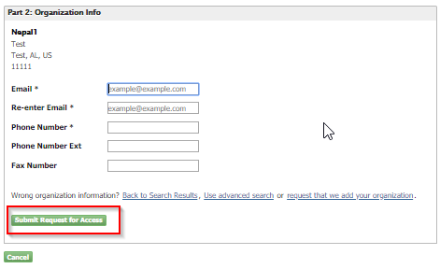
Abatement Notification Role for new CDX user
Notes:
The organization you searched for will be displayed in the table within the Organization Info section. Select your Organization ID from the table, enter all the required information and click “Submit Request for Access.” If your organization does not display select “request that we add your organization” to enter a new organization.

Slide 8
Abatement Notification Role for new CDX user
Notes:
You will be directed to the Confirmation page. Enter the validation code or click the validation link that is sent to the email address you provided on User and Organization Information page.

Slide 9
Abatement Notification Role for new CDX user
Notes:
The validation email gives you the option to click the validation link or enter the validation code on the previous Confirmation page.

Slide 10
Abatement Notification Role for new CDX user
Notes:
You will then be directed to the LexisNexis identity verification page. Enter all the required information and click Proceed with Verification. If you do not pass the electronic identity proofing process you will need to print, sign, and mail the paper form of the Electronic Signature Agreement to EPA.

Slide 11
Abatement Notification Role for new CDX user
Notes:
You will then be prompted to select five security questions and answers.

Slide 12
Abatement Notification Role for new CDX user
Notes:
You are then directed to sign the Electronic Signature Agreement. Click the “Sign Electronically” button.

Slide 13
Abatement Notification Role for new CDX user
Notes:
The attestation clause will then display, click “Accept” after reviewing the information.

Slide 14
Abatement Notification Role for new CDX user
Notes:
The eSignature widget will appear. To finalize your registration, you will have to enter your CDX account password, answer one security question, and click “Sign.”. You will be directed to CDX dashboard with the Abatement Notifications role added to your account.
Note: Proceed to slide 19 for instructions on how to access the Abatement Notifications role in your account.

Slide 15
Adding Abatement Notifications Role for existing CDX user
Notes:
If you do not have Abatement Notifications role on your CDX Dashboard, you can add the role by clicking the “Add Program Service” button.

Slide 16
Adding Abatement Notifications Role for existing CDX user
Notes:
You will be directed to the Program Service page. Click on “Lead: Lead-Based Paint Program”, you will then be redirected to the Role Access page

Slide 17
Adding Abatement Notifications Role for existing CDX user
Notes:
From Select Role dropdown, select “ABATEMENT NOTIFICATION" and click Request Role Access. You will then be directed to the Organization Information Page.

Slide 18
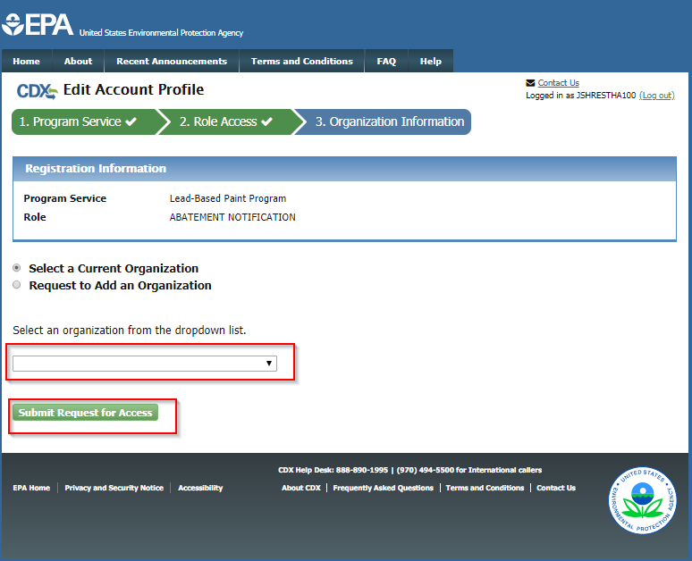
Adding Abatement Notifications Role for existing CDX user
Notes:
On the Organization Information page, select your Organization related to your Abatement Firm Certification and click “Submit Request for Access.” The Abatement Notifications role will be added to your profile which can be accessed through your CDX Dashboard.

Slide 19
Access Abatement Notifications Role
Notes:
Click on the recently added Abatement Notifications role which will direct you to the Abatement Firm Confirmation page.

Slide 20
Access Abatement Notifications Role
Notes:
On the Abatement Firm Confirmation page, enter the certification number of your firm (active or expired). If you have been provided with an access code by someone who is already associated with your firm, select “Yes” for “Have an applicant access code?” and enter the access code in the provided field. If you don’t have an access code, select “no.”

Slide 21
Access Abatement Notifications Role
Notes:
If you do not have an access code, enter the Attesting Individual First Name and the Attesting Individual Last Name. Click “Proceed with Access.” The Attesting Individual is the individual that submitted the firm certification application.

Slide 22
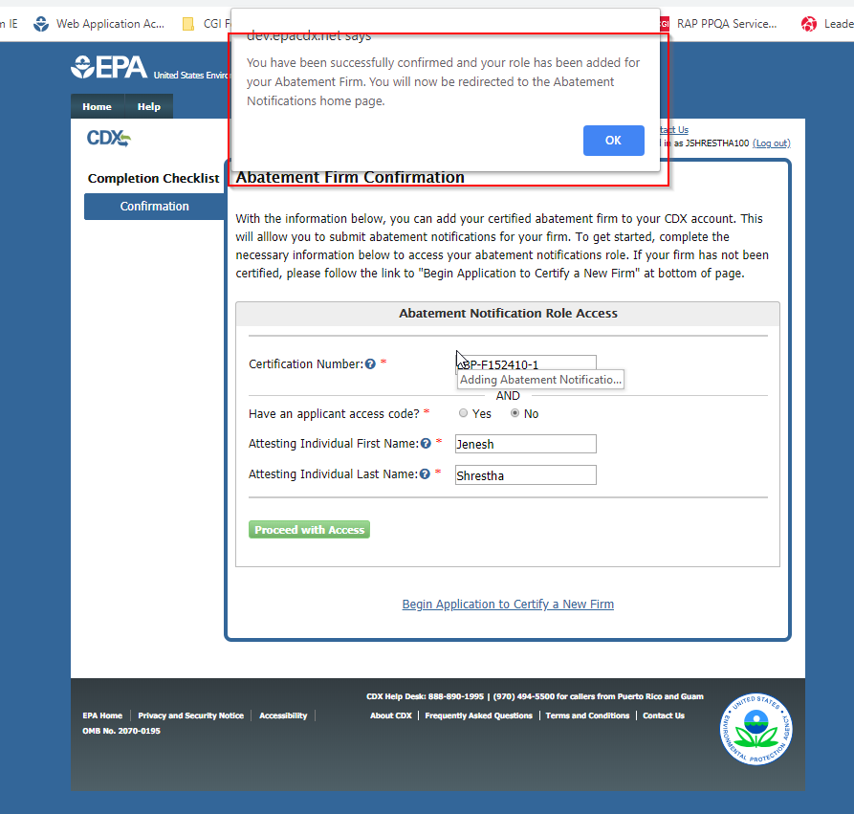
Access Abatement Notifications Role
Notes:
If you enter the correct information, you will get a popup message indicating you will be redirected to the Abatement Notifications home page.

Slide 23
Abatement Notifications Home Page
Notes:
This is the Abatement Notifications home page. On this page, you can view your recent notifications, arranged by activity start date, and update or cancel any of these listed notifications. You can submit a new abatement notification by clicking the “Submit New Notification” button or clicking on the “Submit New Notification” tab. Search your previously submitted notifications by clicking the “Search Notifications” button or the “Abatement Notification Search” tab. You can also generate user Access Codes by clicking the “Access Code Management” tab.

Slide 24
Abatement Notifications Table
Notes:
The Abatement Notifications table displays your recent notifications, arranged by activity start date. You can update or cancel any notification listed on this table. Cancelled notifications will not appear on this table, and will have to be accessed through the abatement notification search. Any other submitted notifications that do not appear on this table can also be accessed through the abatement notification search.

Slide 25
New Abatement Notification
Notes:
To submit a new notification, click the “Submit New Notification” button or “Submit New Notification” tab.

Slide 26
New Abatement Notification - Edit Page
Notes:
This is the full view of the edit page. Continue to the next slide for a breakdown of sections on this page.

Slide 27
New Abatement Notification - Edit Page
Notes:
Section A displays the type of notification being created and the certification expiration date, which cannot be edited. In Section B, use the radio buttons to select whether the notification is an Emergency Notification. If so, you must upload documentation to demonstrate this by clicking the ‘Choose File’ button and selecting the appropriate file. In Section C, enter the dates that lead‐based paint activity will begin and end. The end date must fall before the Certification Expiration Date as shown in Section A.

Slide 28
New Abatement Notification - Edit Page
Notes:
In Section D, answer the questions and enter the required information describing the building where the work is to be performed.

Slide 29
New Abatement Notification - Edit Page
Notes:
The data in section E, Firm Information, is prepopulated from EPA’s Lead Program database and cannot be edited on this form. Finally, in Section F, you must enter the EPA Certification Number and First and Last name of the Certified Supervisor. When all sections have been completed, click ‘Review Form Before Submitting’ to continue.

Slide 30
New Abatement Notification - Review Page
Notes:
The Application Review page displays the data that was entered on the previous page in a read‐only format. Review the information on this page to ensure its accuracy and completeness before submitting the notification. If you would like to make any changes, click the “Edit” button to return to the edit page. Don’t forget to sign enter your first name, last name, and title in section G, Firm Affirmation. Click ‘Sign and Submit’ to submit the application.

Slide 31
New Abatement Notification – Acceptance Statement
Notes:
Read the the attestation clause then click “Accept” to continue.

Slide 32
New Abatement Notification – eSignature Widget
Notes:
The eSignature widget will appear. To finalize your submission, you will have to enter your CDX account password, answer one security question, and click “Sign.”

Slide 33
New Abatement Notification – Submission Confirmation
Notes:
Once the notification has been submitted, the Abatement Firm Submission Confirmation page will be displayed. A Notification Form ID will be generated for your submission.

Slide 34
New Abatement Notification – Email Confirmation
Notes:
You will also be sent an email confirmation containing the same information regarding your submission.

Slide 35
Notification Added to Table
Notes:
Depending on the activity start dates listed on your notification, the table will update with your successfully submitted notification. This table only displays recent notifications, so if the notification you submitted is happening too far into the future, it will not be displayed in the table – in this case, please use the abatement notification search to access your notification.

Slide 36
Abatement Notification Search
Notes:
From the Abatement Notification home page, you can go to the Abatement Notification Search page by clicking the “Search Notification” button or the “Abatement Notification Search” tab to search for any existing abatement notifications.

Slide 37
Abatement Notification Search
Notes:
Enter as many search criteria as desired, then click the “Find Notifications” button.

Slide 38
Abatement Notification Search Results
Notes:
You will then be navigated to the Search Results page, where any notifications matching your search will be displayed. The results table works similarly to the notifications table on the home page. You have the choice to update or cancel any of your prior submissions, view a notification, or view a notification’s version history. Cancelled notifications will appear on the table, but no action can be taken on these notifications. However, you can still view a cancelled notification’s version history.

Slide 39
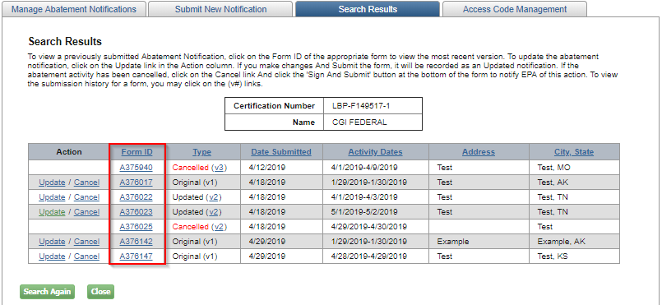
View Submitted Notification
Notes:
To view a submitted notification, click the notification’s Form ID on Abatement Notifications Home table or Search Results table.

Slide 40
View Submitted Notification
Notes:
On this view page, you will also have the option to update the notification by clicking “Edit Abatement Notification.”

Slide 41
Update Abatement Notification
Notes:
To update a notification, click on the “Update” action option next to the notification you want to update.

Slide 42
Update Abatement Notification – Edit Page
Notes:
On the edit page, make any edits to your previously submitted notification. When you are done updating the information, click “Review Form before Submitting.”

Slide 43
Update Abatement Notification – Review Page
Notes:
The review page displays the data that was entered on the previous page in a read‐only format. Review the information on this page to ensure its accuracy and completeness before submitting the update. If you would like to make any changes, click the “Edit” button to return to the edit page. Don’t forget to enter your first name, last name, and title in section G, Firm Affirmation. Click ‘Sign and Submit’ to submit the update.

Slide 44
Update Abatement Notification – Acceptance Statement
Notes:
Read the the attestation clause then click “Accept” to continue.

Slide 45
Update Abatement Notification – eSignature Agreement
Notes:
The eSignature widget will appear. To finalize your update, you will have to enter your CDX account password, answer one security question, and click “Sign.”

Slide 46
Update Abatement Notification – Submission Confirmation
Notes:
Once the update has been submitted, the Abatement Firm Updated Confirmation page will be displayed.

Slide 47
Update Abatement Notification – Email Confirmation
Notes:
You will also be sent an email confirmation containing the same information regarding your update.

Slide 48
View Version History
Notes:
When a notification is updated, its “Type” is changed to “Updated (v2)” on the table. Click “v2” to view your notification’s version history.

Slide 49
Version History Page
Notes:
This is the Version History page. Here you will see when you originally submitted your abatement notification, as well as the dates of any updates you sent in.

Slide 50
Cancel Abatement Notification
Notes:
To cancel a notification, click on the “Cancel” action option next to the notification you want to cancel.

Slide 51
Cancel Abatement Notification – Review Page
Notes:
Review the information on the notification you want to cancel and enter your first name, last name, and title in section G, Firm Affirmation, then click ‘Sign and Submit.’

Slide 52
Cancel Abatement Notification – Acceptance Statement
Notes:
Read the the attestation clause then click “Accept” to continue.

Slide 53
Cancel Abatement Notification – eSignature Widget
Notes:
The eSignature widget will appear. To finalize your cancellation, you will have to enter your CDX account password, answer one security question, and click “Sign.”

Slide 54
Cancel Abatement Notification – Submission Confirmation
Notes:
Once the cancellation has been submitted, the Abatement Firm Cancellation Confirmation page will be displayed.

Slide 55
Cancel Abatement Notification – Email Confirmation
Notes:
You will also be sent an email confirmation containing the same information regarding your cancellation.

Slide 56
View Cancelled Abatement Notifications
Notes:
To view cancelled notifications, click on the “Show Cancelled Notifications” action option.

Slide 57
View Cancelled Abatement Notifications
Notes:
The cancelled notifications will appear on the home screen.

Slide 58
View Cancelled Abatement Notifications
Notes:
The cancelled notification can also be searched in the Abatement Notification Search Results page.

Slide 59
Access Code Management
Notes:
From the Abatement Notification home page, you can go to the Access Code Management page by clicking the “Access Code Management” tab. This tab will provide the most recent access code or allow you to generate a new access code.

Slide 60
Generate New Access Code
Notes:
To generate a new access code, click the “Generate New Access Code” button above the access code table. The table displays previous access codes, the date they were generated and their status.

